Slide 1
The Path Most Travelled
Carson Kaylor, Erik Akeyson, Sebastian Martin,
Robby Carff, Jack Stemper

Slide 2
Goals for this Capstone Project
Our app is meant to create a framework for grouping up locations and passing them to other people
What could this possibly be used for?
Touring historic and famous locations in a city you are visiting
Completing a bar crawl with some friends
Getting all of your shopping done ( or passing the locations on to a family member)

Slide 3
Benefits
Available to anyone at anytime, no “tour guide” is needed
Allows for more freedom while touring
Users can take as much time as they need
Easy to use as compared to setting up a tour date
Just download and search
Makes finding tours easier around the globe

Slide 4
Technology Used
Android based app, written in Java
Uses firebase to store users, tours, and other data
Uses firebase user authentication
Google maps APK

Slide 5
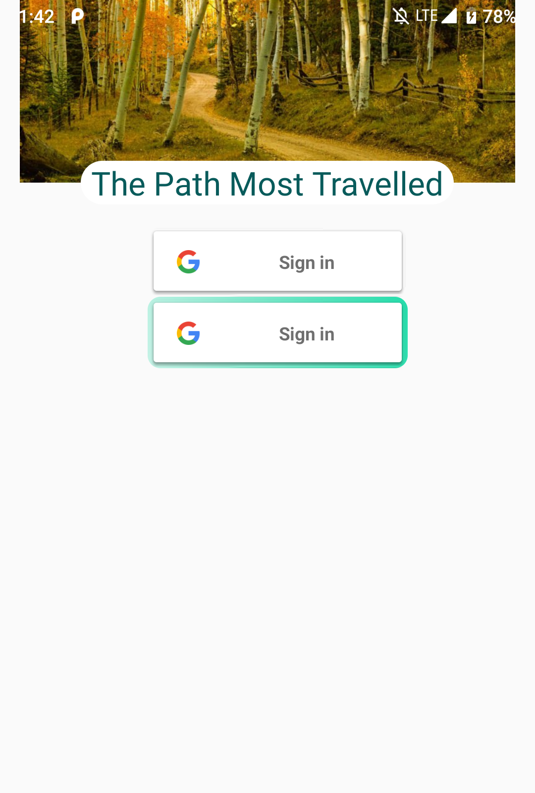
Welcome
Allows 2 types of sign in
Google Account sign in (top button)
Email and Password Registration (Lower button)

Slide 6
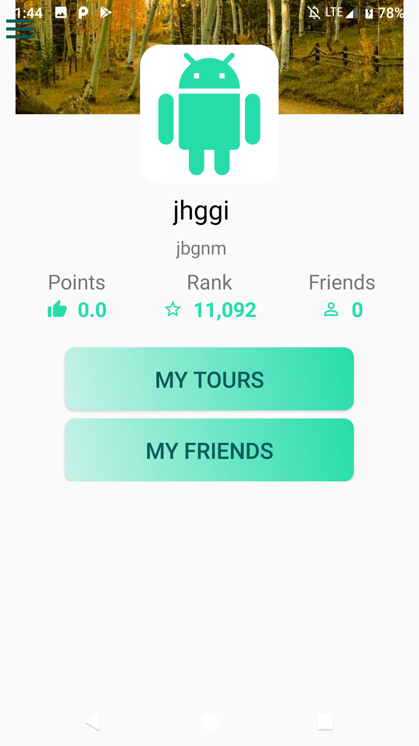
Profile
Points – Represents points earned from completing tours
Rank – Ranks users based on points
Friends – Shows number of friends one has
My tours – Navigates to the tours options
My Friends – Navigates to friends menu

Slide 7
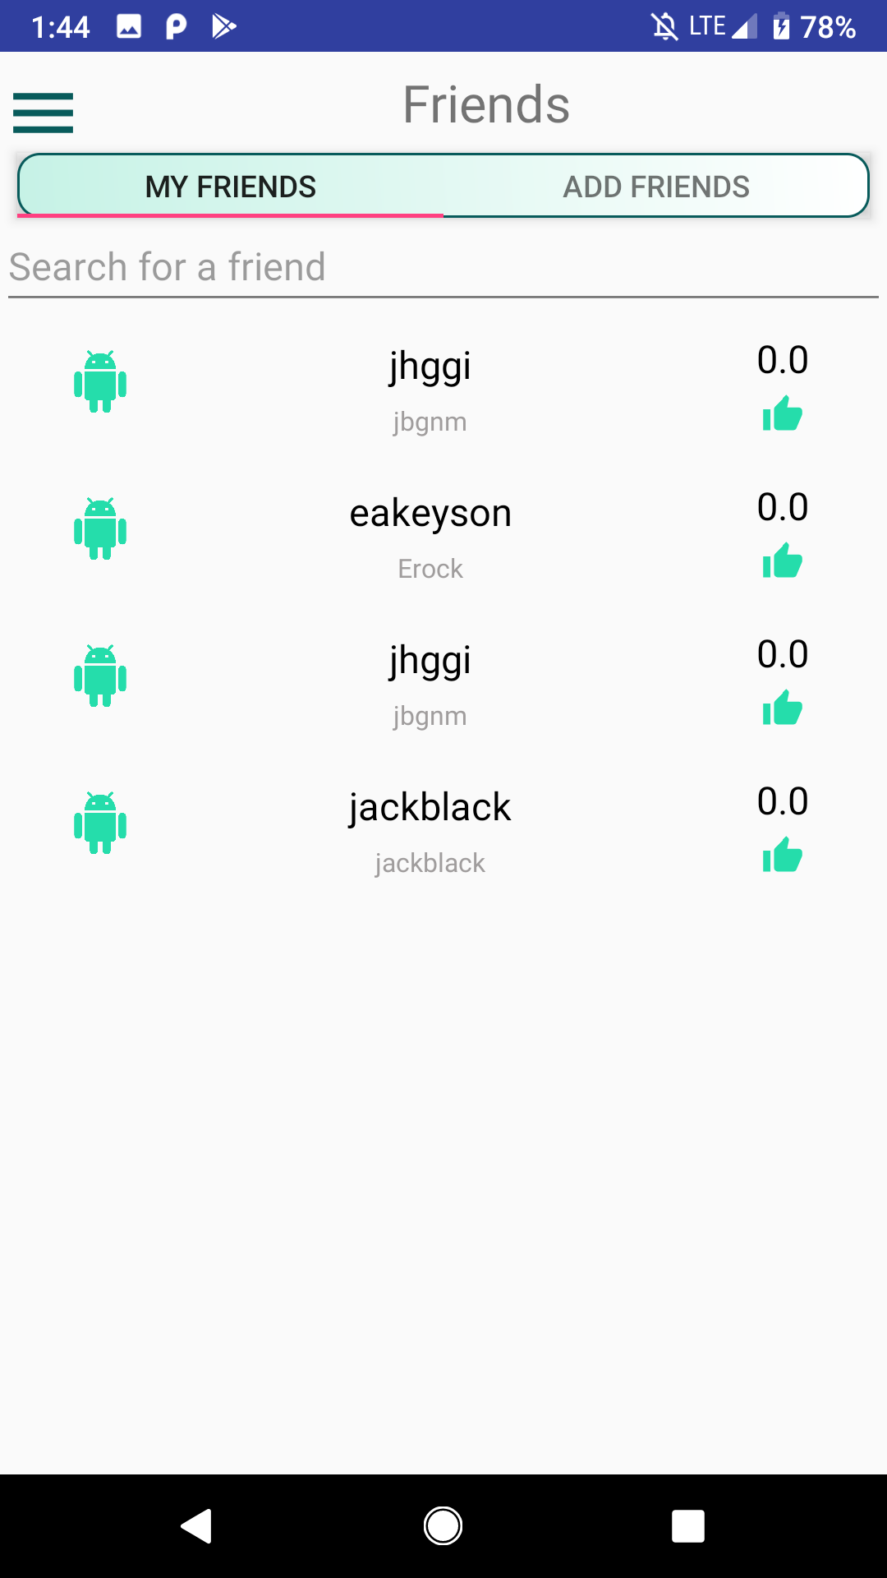
My Friends List
Shows friends
Allows Navigation to your friends profile to view their stats, and to view/save their saved tours

Slide 8
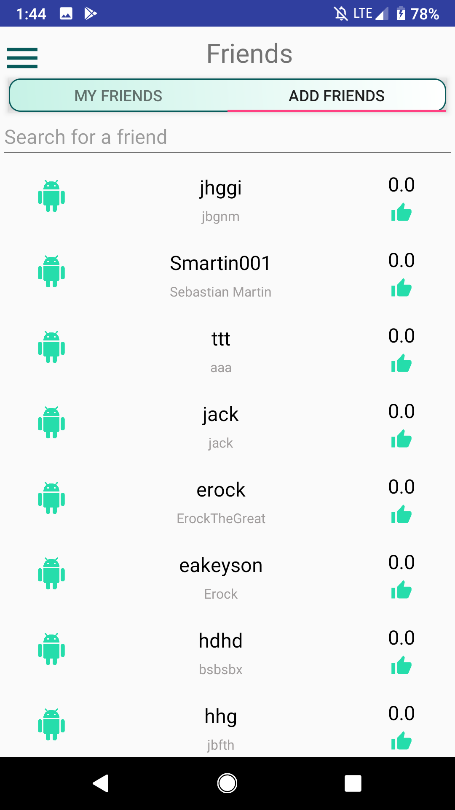
Public Friends
Shows users in a list
Clicking on a friend pulls up a friends information and asks if one wants to add the friend.

Slide 9
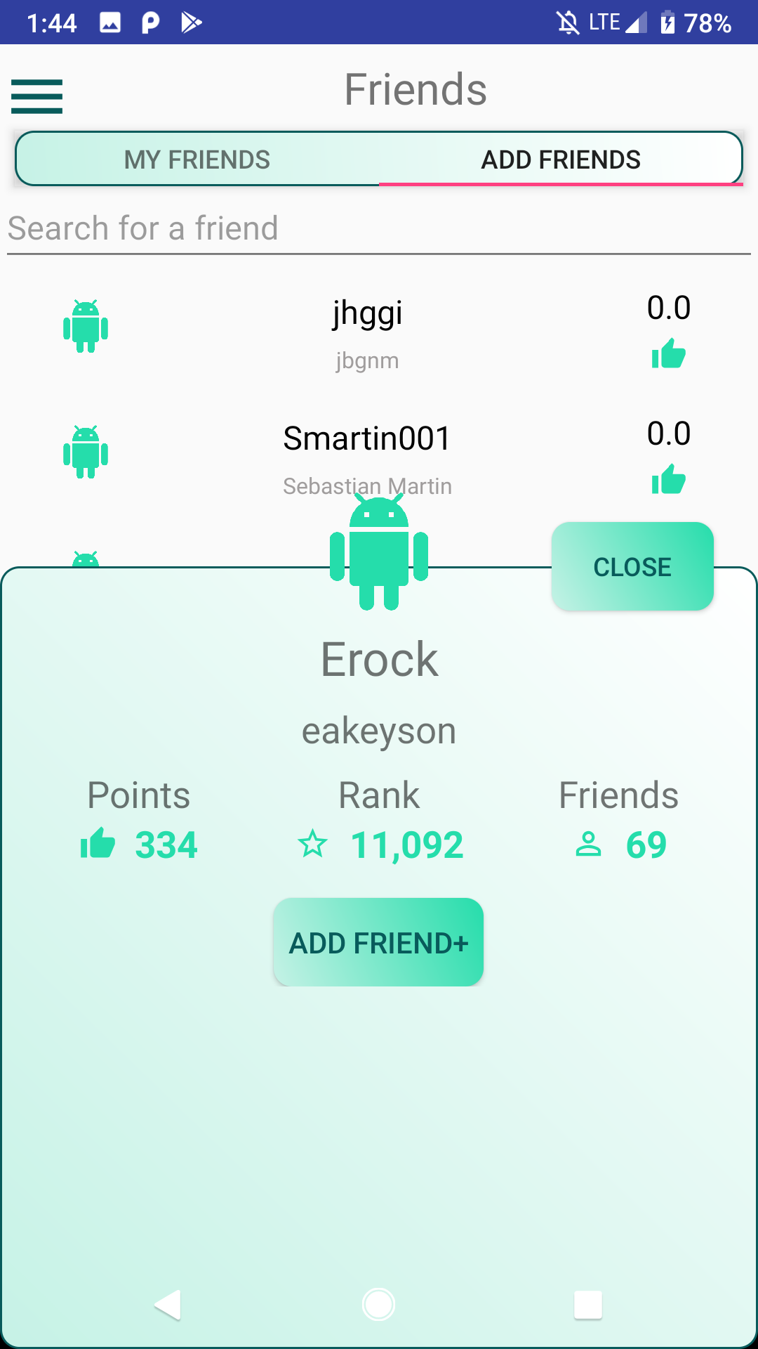
Adding a friend
Clicking add friend+ saves user to your friends list
Displays user's stats
Returns to public friends list with close

Slide 10
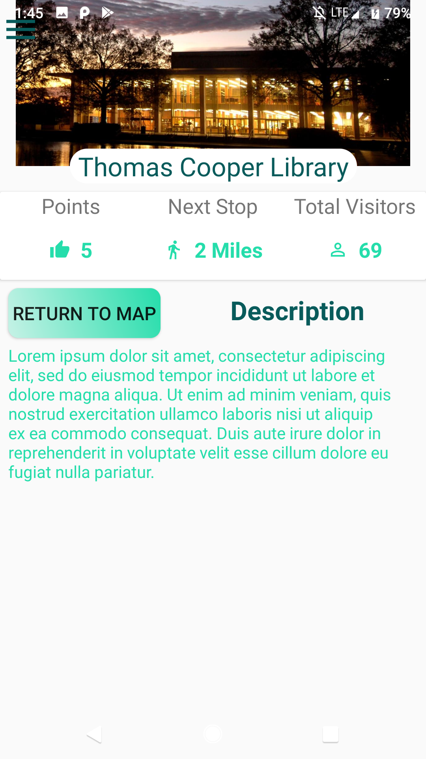
Stop Details
Displays info about a stop on a tour
Displays points received, distance to next tour stop, and total visitors
Returns to map with button click
Has user inputted info about the stop

Slide 11
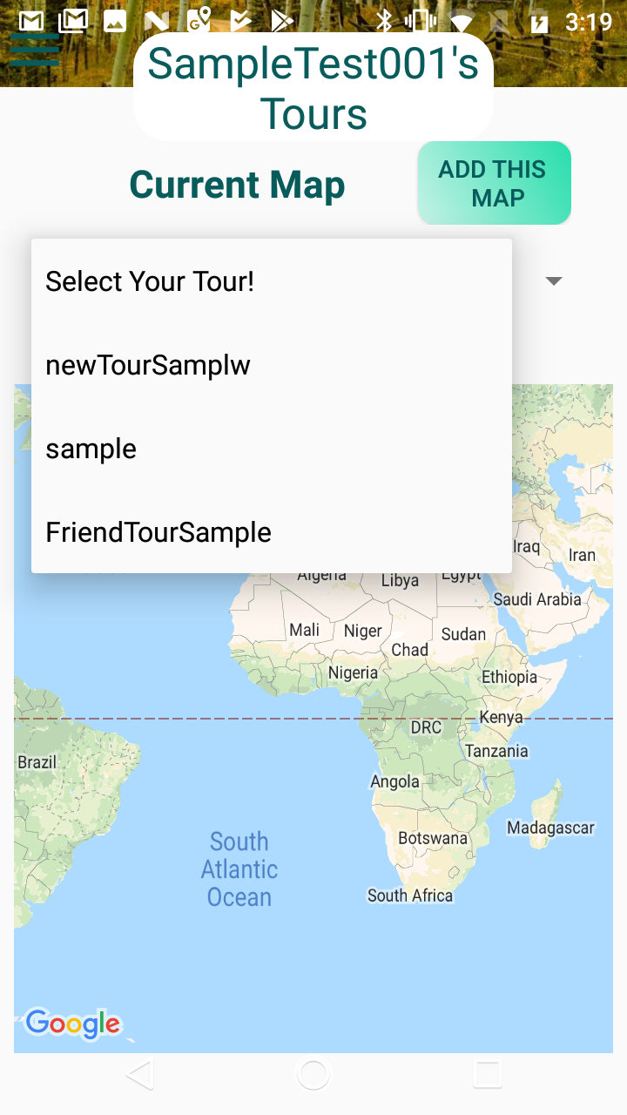
MY Tours
Displays a map
Has a list of tours that the user already made
Selects pervious tour if clicked on

Slide 12
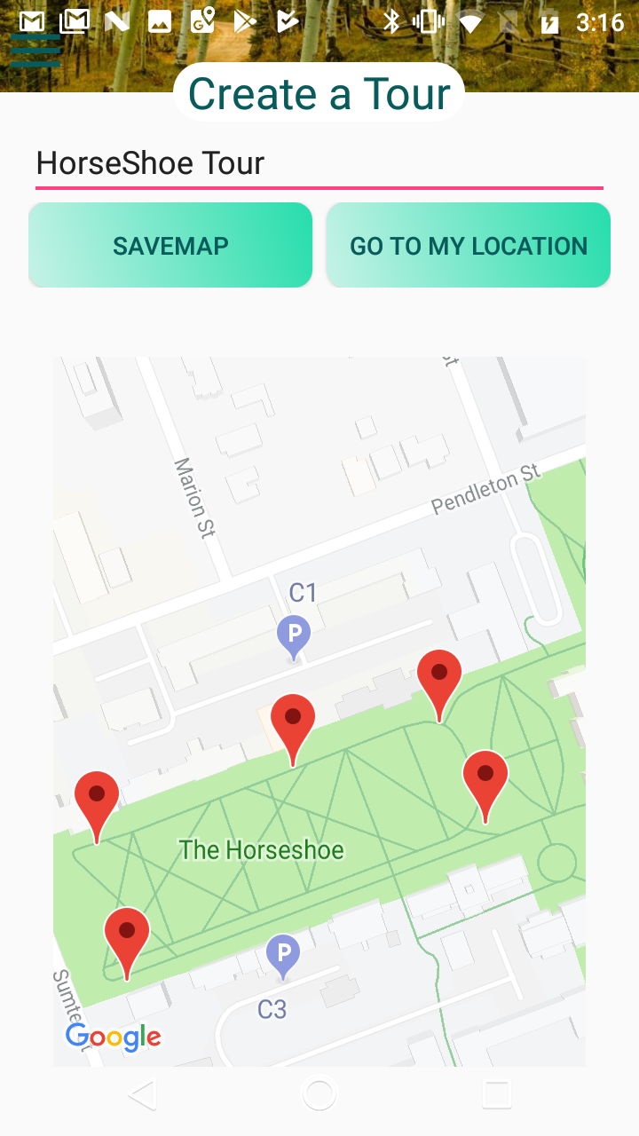
Tour Creation
Allows user to place points on a map
Displays points received
Saves map with click of “Save Map”
Go to my location centers map on user if location services are enabled

Slide 13
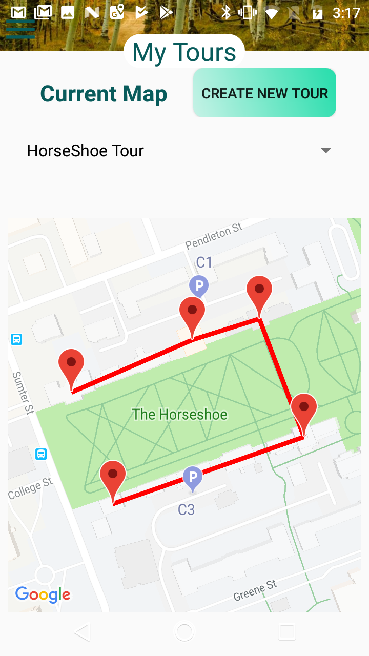
Current Tour
Displays Map
Displays points placed on the map
Allows the selection of other tours

Slide 14
Future Implementation
Directions from point to point
Route displayed on map (Standard GPS style)
Be able to take user from point to point

